Slide 1


Slide 2

You have to learn accounting. It's the language of the business. If you don't know it, it's like being in a foreign country without knowing the language.
--Warren Buffet (2003)
Accounting is more than “counting” number!

Slide 3

Chapter 1
Conceptual Framework and Financial Statements

Slide 4
Important questions
What is Accounting?
Who are the users of Accounting information? What kind of information do they need?
Why do we need an Accounting standard? What’s the purpose of setting up a conceptual framework?
What exactly are we Accounting for? What are the relationships among the financial statements?

Slide 5

History of accounting
The history of accounting is
thousands of years old.
The concept of “shareholders”
was born during the 13-14th centuries when the trading
ventures grew fast between Europe and the Middle East.
The Italian Luca Pacioli published a work on double-entry accounting in 1494, and he was recognized as The Father of accounting and bookeeping.

Slide 6
Agency problem
Moral hazard
Adverse selection
Delegate Authority
Selective information
Shareholders (Principal)
Manager (Agent)
Reports

Slide 7
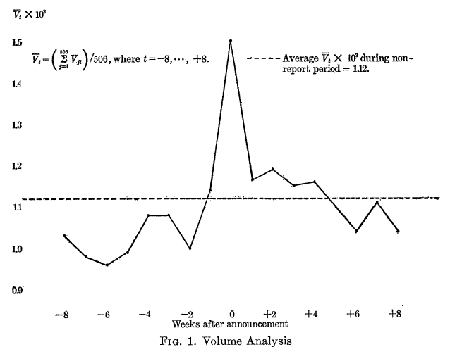
Beaver (1968): The Information Content of Annual Earnings Announcements

Slide 8
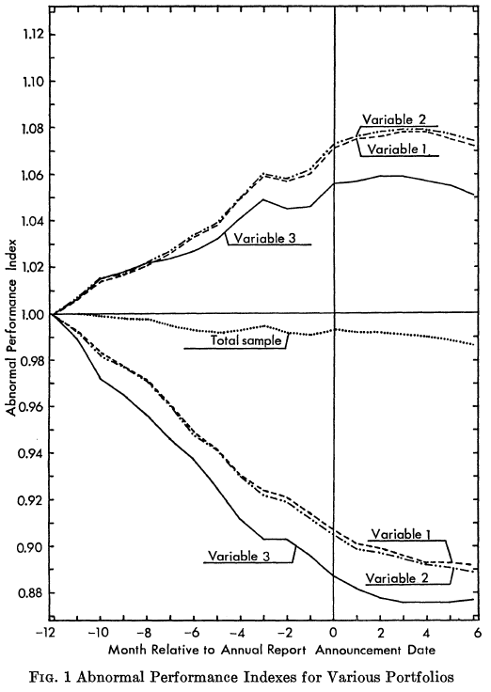
Ball and Brown (1968): An Empirical Evaluation of Accounting Income Numbers

Slide 9
Accounting is the Language of Business
Measures business activities
Processes data into reports
Communicates results to financial statement users

Slide 10
Types of Accounting
This Class
Financial
Managerial
Provides information for external users
Investors
Creditors
Government
The public
Provides information for internal users – managers
Includes:
Budgets
Forecasts
We will focus on Preparing and Interpreting Financial Statements

Slide 11
Forms of Business Organization
 | Proprietorship | Partnership | Corporation (Limited Company)
Owner(s) | Proprietor – One owner | Partners – two or more owners | Shareholders – generally many owners
Personal liability of owner(s) for business debts | Proprietor is personally liable | General partners are personally liable; limited partners are not | Shareholders are NOT personally liable
Examples? | small retails stores and professional service providers: physicians, attorneys, software programmers | accounting firms, law firms | Apple, Google, Starbucks, China Mobile, ICBC, Vanke

Slide 12

International Financial Reporting Standards (IFRS)
Historically, different countries use their own accounting standards.
Difficult for investors to compare companies that operate in different countries
The IASB has developed international standards (IFRS)
Hong Kong Financial Reporting Standards (HKFRS) - set by the Hong Kong Institute of Certified Public Accountants (HKICPA) – are almost the same as IFRS
China Accounting Standards (CAS), set by China Accounting Standards Committee, Ministry of Finance, has converged to IFRS since 2oo7. Some major differences remain: related party identification, reversal of impairment losses, etc.
Copyright ©2014 Pearson Education

Slide 13
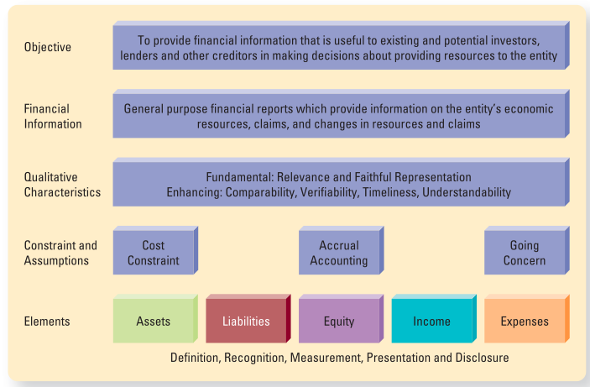
Conceptual Framework of Accounting

Slide 14
Users of Accounting Information
Investors
Employees
Creditors
Suppliers and trade creditors
Customers
Government and its agencies
Public

Slide 15
What Makes Accounting Information Useful?
Relevance
(useful for decision making)
Faithful representation
(complete, neutral, free from error)
Qualitative Characteristics - Fundamental

Slide 16
Qualitative Characteristics - Enhancing
Comparability
(across companies and across time)
Verifiability (helps ensure faithful representation)
Timeliness
(early enough to make decision)
Understandability (makes sense to users)

Slide 17
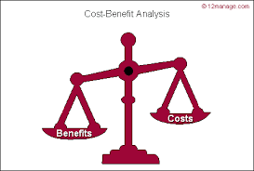
Constraints
Benefits vs Costs
Cost: Cost of data collection, processing, verifying and disseminating information
Will benefits>cost?

Slide 18

Assumptions
Accrual Accounting
Transactions and other events are recognized when they occur
Going- concern assumption
Entity will continue to exist indefinitely
Copyright ©2014 Pearson Education

Slide 19
What Exactly are We Accounting for?
Cash, inventory, accounts receivables, PPE
Bank loans, accounts payables
Share capital, retained earnings
Revenue vs. gains
Salaries, rent expenses Expenses vs. losses
Examples
Assets
Economic resources
Liabilities
Present obligations
Result in an outflow of economic benefits
Equity
Represents shareholders’ residual claim to the entity’s assets
Income
Increases in economic benefits during an accounting period
Expenses
Decreases in economic benefits during an accounting period
Produce future benefits
Copyright ©2014 Pearson Education

Slide 20
Basic Accounting Equation, also called “Balance Sheet Equation”
Assets = Liabilities + Equity
Assets
$1,000
Liabilities
$600
Equity
$400
Equity or Shareholders’ Equity or Owners’ Equity
Copyright ©2014 Pearson Education

Slide 21
Total Revenue and Gain – Total Expenses and Losses = Net Income (or Loss)
Total Revenue and Gains
$500
Total Expenses and Losses
$300
Net Income (or Loss)
$200
Copyright ©2014 Pearson Education

Slide 22
The Components of Retained Earnings
Revenues for the period
minus
Expenses for the period
equals
Plus or minus
Beginning Balance of Retained Earnings
Net Income (or Net Loss) for the period
Dividends for the period
Ending Balance of Retained Earnings
minus
equals
Copyright ©2014 Pearson Education

Slide 23
The Financial Statements
How the financial information flows from one financial statement to the next. The order is important.
Income Statement
Statement of Changes in Equity
Balance Sheet
Statement of Cash Flows
Copyright ©2014 Pearson Education

Slide 24
Relationships between Financial Statements
Income Statement For the year ended December 31, 20X6
Revenues | $700,00
Expenses | (670,000)
Net income | $30,000
Statement of Changes in Equity For the year ended December 31, 20X6
Beginning equity | $160,000
Net income | 30,000
Cash dividends | (10,000)
Ending equity | $180,000
Copyright ©2014 Pearson Education

Slide 25
Statement of Changes in Equity For the year ended December 31, 20X6
Beginning equity | $160,000
Net income | 30,000
Cash dividends | (10,000)
Ending equity | $180,000
Balance Sheet on December 31, 20X6
Assets | $300,000
Liabilities | 120,000
Shareholders’ equity:
Share capital | 40,000
Retained earnings | 140,000
Total liabilities and equity | $300,000
Copyright ©2014 Pearson Education

Slide 26
Balance Sheet on December 31, 20X6
Assets Cash | #300,000 35,000
Liabilities | 120,000
Shareholders’ equity:
Share capital | 40,000
Retained earnings | 140,000
Total liabilities and equity | $300,000
Cash from the Asset section of the Balance
Sheet equals ending Cash on the Statement of Cash Flows
Statement of Cash Flows For the year ended December 31, 20X6
Cash flows from operating activities | $55,000
Cash flows from investing activities | (15,000)
Cash flows from financing activities | (10,000)
Net cash flows | 30,000
Cash balance, December 31, 2015 | 5,000
Cash balance, December 31, 20106 | $35,000
Copyright ©2014 Pearson Education

Slide 27
1. The Income Statement
part of Statement of Comprehensive Income
Also called Profit and Loss Statement (P&L)
Reports two main categories
Revenues and gains
Expenses and losses
Shows the “bottom line”
Net income or net loss for the period
Copyright ©2014 Pearson Education

Slide 28
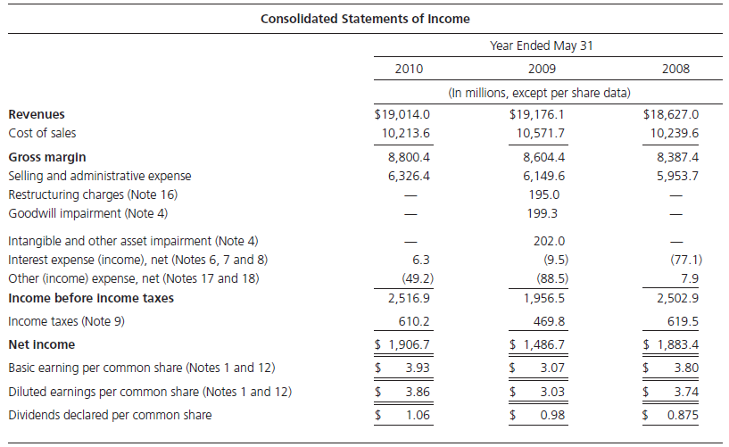
The Income Statement:
Nike, Inc., 2010
2-

Slide 29
2. Statement of Changes in Equity
The Statement of Changes in Equity shows a company’s transactions with its owners.
[ONLY] Net income (or net loss) flows from the Income Statement to the Statement of Changes in Equity.
For simplicity, we will sometimes refer to a Statement of Changes in Retained Earnings
Copyright ©2014 Pearson Education

Slide 30
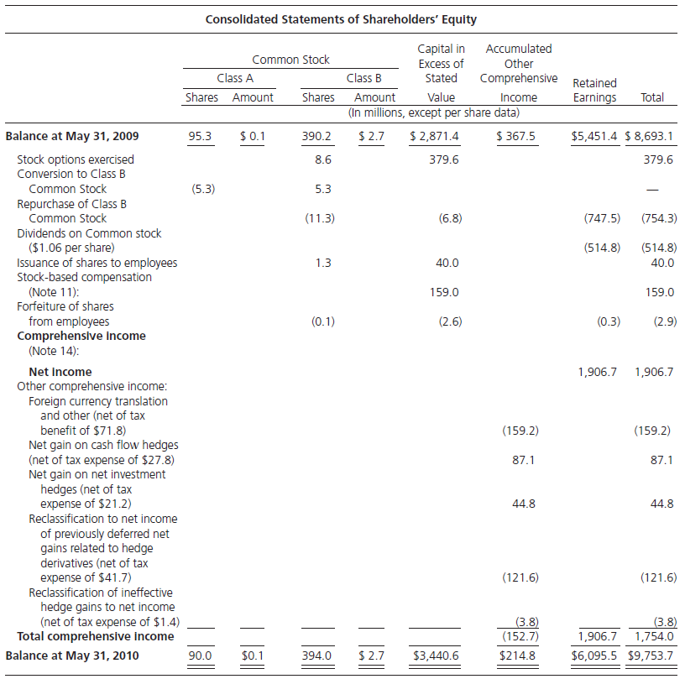
The Statement of Shareholders’
Equity:
Nike, Inc., 2010
2-

Slide 31
3. The Balance Sheet
Also called the Statement of Financial Position
Reports
Assets
Liabilities
Shareholders’ equity
Copyright ©2014 Pearson Education

Slide 32
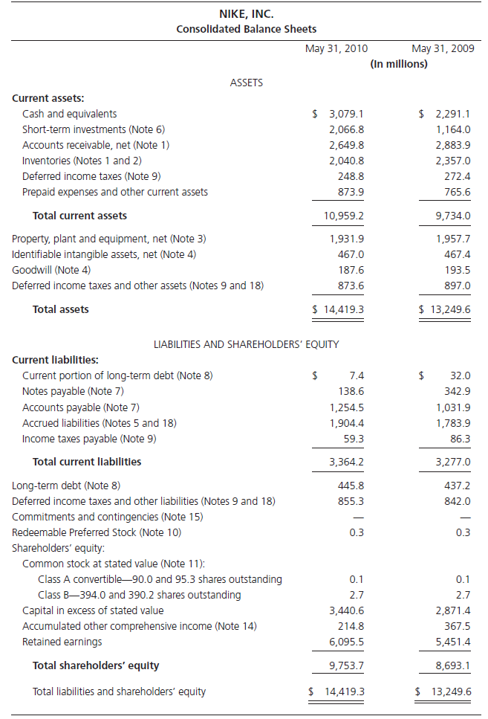
The Balance Sheet:
Nike, Inc., on May 31, 2010
2-

Slide 33
4. The Statement of Cash Flows
Measures cash receipts and cash payments
Categorizes into three types of activities:
Operating
Investing
Financing
Change in Cash = Cash from Operations
+ Cash from Investing
+ Cash from Financing
Copyright ©2014 Pearson Education

Slide 34
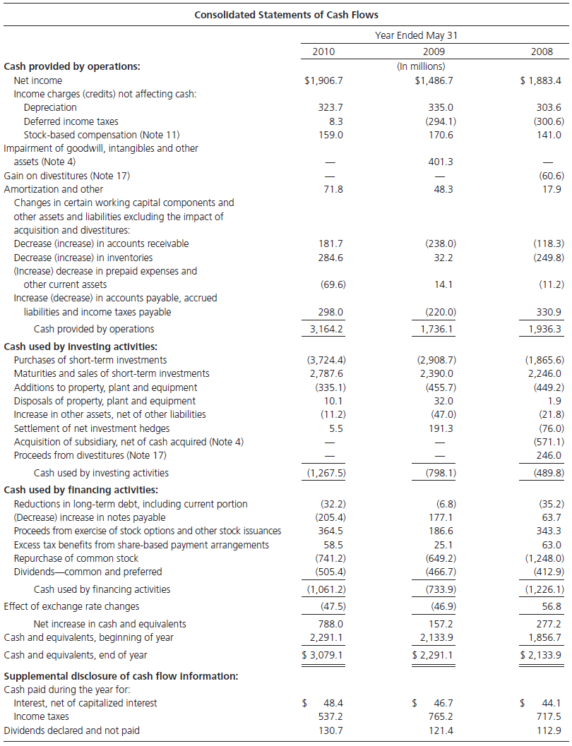
The Cash Flow Statement :
Nike, Inc., 2010
2-

Slide 35
The Articulation of the Financial Statements:How They Fit Together
Beginning stocks
Flows
Ending stocks
Cash Flow Statement
Cash from operations
Beginning Balance Sheet
Cash from investing
Ending Balance Sheet
Cash from financing
Cash
Net change in cash
Cash
Other Assets
+ Other Assets
Statement of Shareholders’ Equity
Total Assets
Total Assets
- Liabilities
Investment and disinvestment by owners
- Liabilities
Net income and other comprehensive income
Owners’ equity
Net change in owners’ equity
Owners’ equity
Income Statement
Revenues
-Expenses
Net income
2-

Slide 36
Main points of Chapter1
Accounting is an information system. It measures business activities, processes that information into reports and financial statements, and communicates the results to decision markers.
IFRS aims to have all the countries use the same set of accounting standards, so that investors can compare financial results across entities from different countries..
Conceptual framework resolves the big issues in Accounting: “Why, Who, What, How”.

Slide 37
Main points of Chapter1
Basic assumptions of Accounting: Accrual basis, going concern.
Fundamental qualitative characteristics of accounting: Relevance+ Reliability(faithful representation )
Understand accounting elements and accounting equations:
Assets=Liability + Equity
Net income=Revenue-Expenses
Relationships among the financial statements.

Slide 38
What will we learn in Chapter 2?
How to analyze business transactions?
How accounting works?
Journals, trial balance, T-accounts

